Slide 1
PERSUASION using Rhetorical Devices
Rhetoric is a fancy word for using persuasive techniques in writing or speaking.

Slide 2
A speaker or writer MUST consider both the audience and purpose.
For example: If you are talking to an elementary school class, your topic, word choice, and tone will be different than if you were speaking to a high school class.
Another example: When you talk to your friends, your topic, word choice, and tone are different than when you talk to your parents or teachers.

Slide 3
Ethos
“You can trust me.”
Convince the audience that you are qualified to speak on the subject.
A high school football player gives speech about the time and discipline required to be a successful football player.
If you are sick, you are not going to go to your mechanic for help.

Slide 4
Ethical Mistakes
Appearing ill-informed or misinformed
Appearing not to care about your audience’s point of view

Slide 5
Demonstrate Your Intelligence
That you have done research
Use specialized language
Cite background information or relevant life experience
Avoid name calling or irrelevant arguments

Slide 6
Demonstrate Your Character
Cite approval from respected authorities
Cite your history of caring
Refrain from telling lies or making threats

Slide 7
Demonstrate Good Will
Recognize the needs of your audience
Give background info
Don’t talk down to your audience
Acknowledge counterclaims
State why your argument deserves to be heard

Slide 8
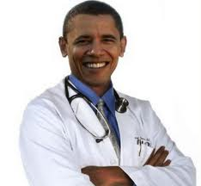
Example: An actor in a pain reliever commercial puts on a doctor’s white coat; they are hoping the coat will give the actor the authority to talk persuasively about medicines.

Slide 9
Logos
Logos refers to any attempt to appeal to the intellect. Everyday arguments rely heavily on ethos and pathos, but academic arguments rely more on logos.
Use clear and reasonable ideas with proof (any statistic)

Slide 10
Without Logos
Our arguments are little more than emotion which may be seen as manipulative

Slide 11
Ways to add logos to your argument
Similar Case
Example: Dad, can I get a part-time job? Tim has one and he’s keeping an A-B average in his classes which are the same as mine.
2. Cause/Effect
Example: The bee population is reduced when harsh chemicals are used on plants.
Non-example: If I don’t go to school tomorrow, I’ll get an F on my test which will lower my self-esteem causing my grades to suffer more and I won’t get into a good college or get a good job.

Slide 12
Logos
Examples:
The government tells us that every year 7,000 workers are needed to pick produce; Americans will not do the work. It is hard work and pays $2 for 25 lbs. picked.
Nine out of ten dentists prefer Crest toothpaste.
If you have a good education, you are more likely to find a good job.

Slide 13
Pathos
Pathos is related to the words pathetic, sympathy and empathy. Whenever you accept a claim based on how it makes you feel without fully analyzing the reasons behind the claim, you are acting on pathos.
As the writer or speaker, you try to appeal to their emotions.
You may want them to feel sympathy or joy
Effect of appeal: Evokes a personal, emotional response.

Slide 14
Remember
Pathos must be used with logic to be effective.
Smart audiences see through an argument that is just emotion.

Slide 15
Three Types of Audiences
Hostile: They’re already feeling emotion…just not the right one. Your job is to turn that emotion into a different one. Will you change anger into surprise? Disgust into sadness? Sadness into anger?
Indifferent: They don’t care. You need to make them feel something. Build on something they do dare about and connect it to your ideas.
Accepting: They already agree with you. What do you want them to do or think?

Slide 16
Example: A group that is collecting money for an animal care facility will first show you pictures of very sad looking dogs and cats.

Slide 26
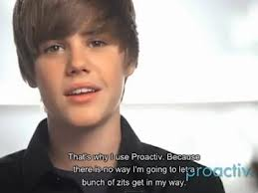

Slide 29
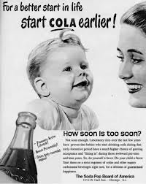

Slide 30
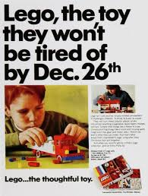

Slide 31
