Slide 1
IRONY
The opposite of what you’d expect happens or is said.

Slide 2
VERBAL IRONY 2slides
Verbal irony =says things they don’t mean-sarcasm.
“He’s so smart, he failed all his subjects.”
“The locker room smells really good.”
“I loved the old man…I think it was his eye…I made up my mind to get rid of the eye forever”!

Slide 3
DRAMATIC IRONY
Dramatic irony =reader knows something that a character doesn’t. They’re in on a secret.
Tim’s parents are proud of the “A” he got on the test, but we know he cheated.
The narrator is clearly insane, but he keeps saying he isn’t. (“Tell-Tale Heart”}

Slide 4
SITUATIONAL IRONY-2 slides
Irony of situation=the opposite of what you would expect happens.
A vampire has a cross in his house.
A vegetarian wears a leather belt.

Slide 5
A student is given the attendance award and is absent to receive it!
A man who is a traffic cop gets his license suspended for unpaid parking tickets.

Slide 6
Review
Something that is ironic is unexpected.
If unexpected by a character, it’s dramatic.
If unexpected by everyone, it’s situational.
If it’s sarcasm, it’s verbal.

Slide 7
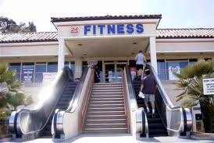

Slide 8
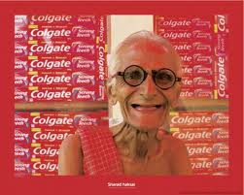

Slide 9
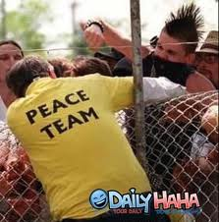

Slide 10
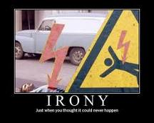

Slide 11
