Slide 1
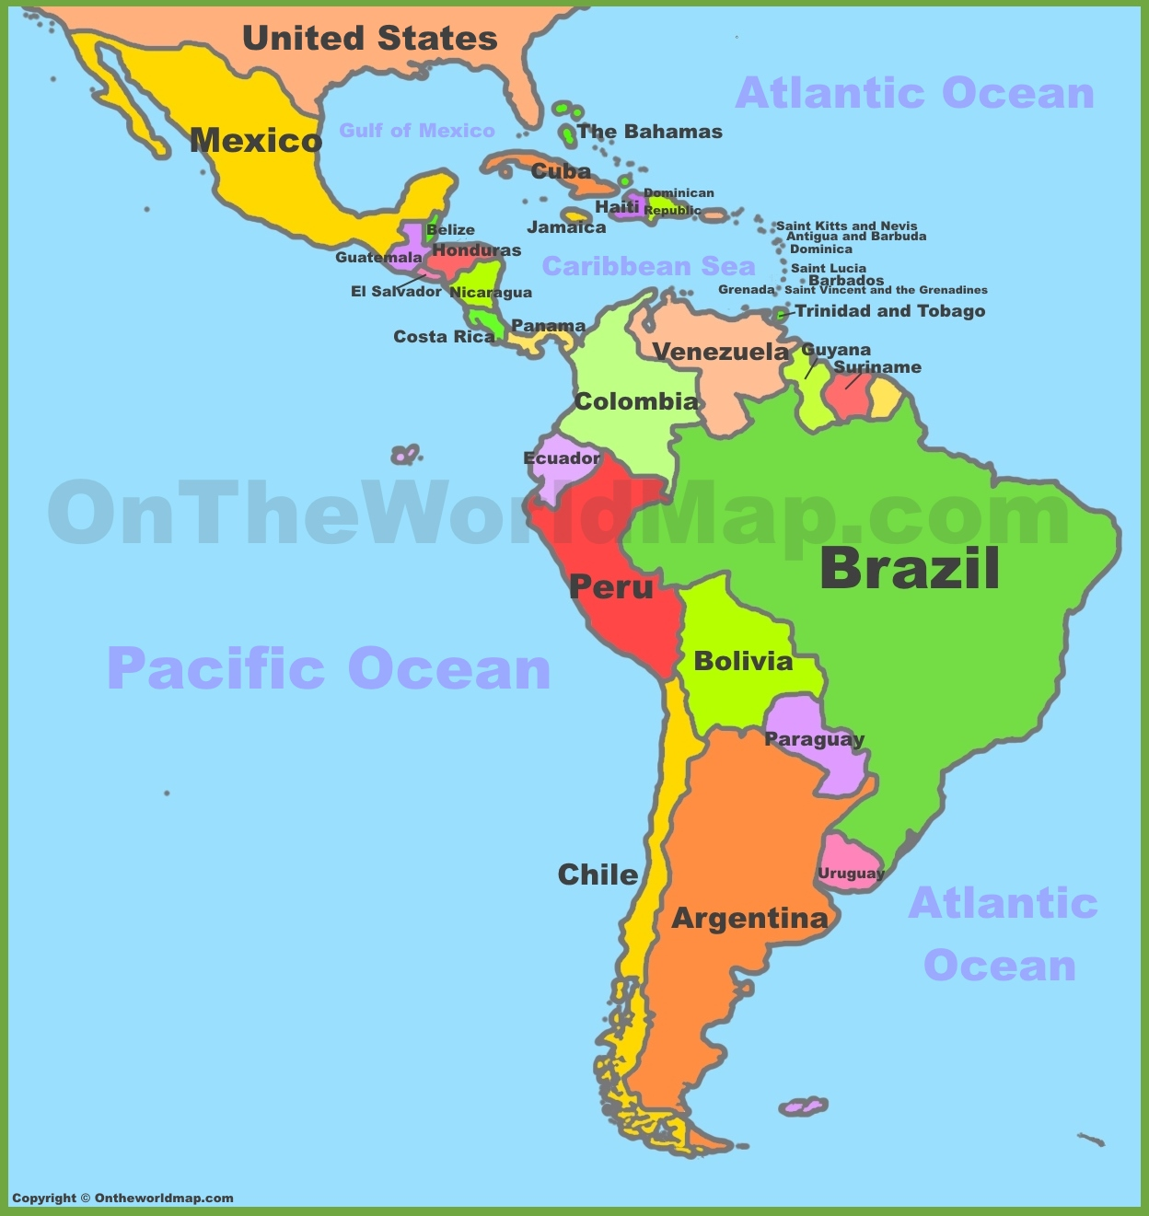
Chapter 3.4 (copy red) Government and Economy of Latin America

Slide 2
To understand their governments & economies today, we need to look back.

Slide 3
How do countries become wealthy?
Focus Question for the Chapter
How have democracy and economic diversification affected Latin America?
Ask yourself
If they only export coffee or bananas, how might this be a problem?
What does economic diversification mean?
What is a democracy?

Slide 4
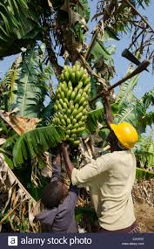
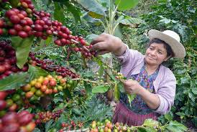
Economic Diversification
A country makes money in a variety of ways, not just selling coffee or bananas.
They export many different goods.

Slide 5
Democracy
form of government in which citizens have a say by voting

Slide 6
Let’s look at a leader of Argentina
Read about Juan Peron, a leader of Argentina in 1948

Slide 7
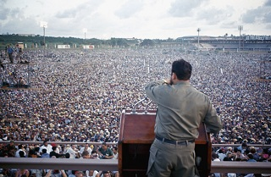
Juan Peron

Slide 8
Juan Peron [1:43]
https://www.youtube.com/watch?v=u2r9GpbybUc

Slide 9
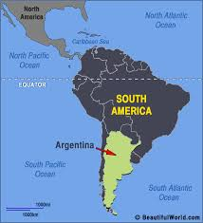
Read 3.4 Engage & Answer the questions

Slide 10
Exporting Raw Materials
Read page one of Explore and answer the question:
What activities dominated early Latin American economies?
Define infrastructure.
roads, bridges and communication networks like electricity, etc.

Slide 11
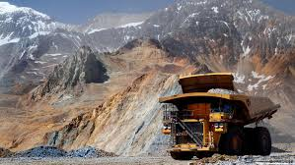

Slide 12
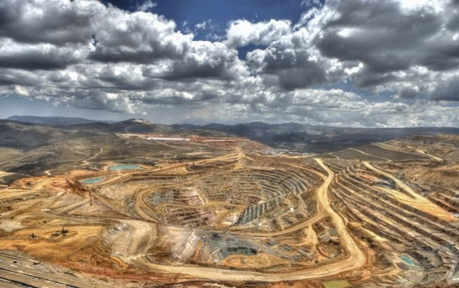
Strip Mining

Slide 13
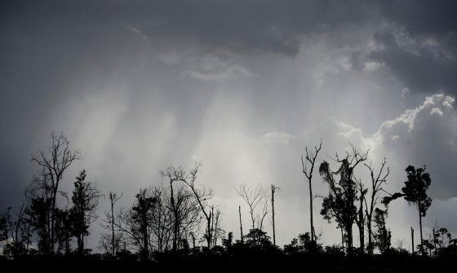
Degraded forest in Brazil because of logging, due to high demand for the area’s vast forestry resources. Authorities attempt to find a balance between exploitation of natural resources and sustainability.

Slide 14
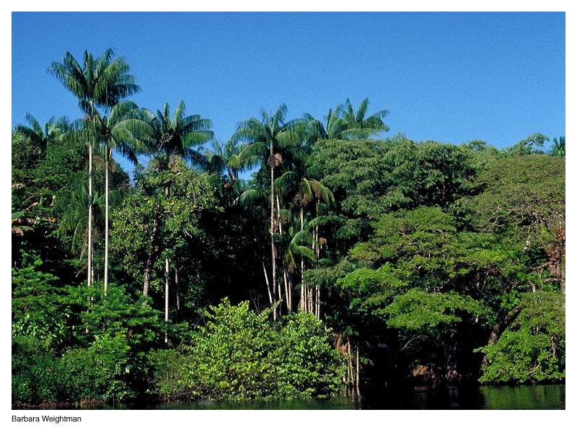

Slide 15
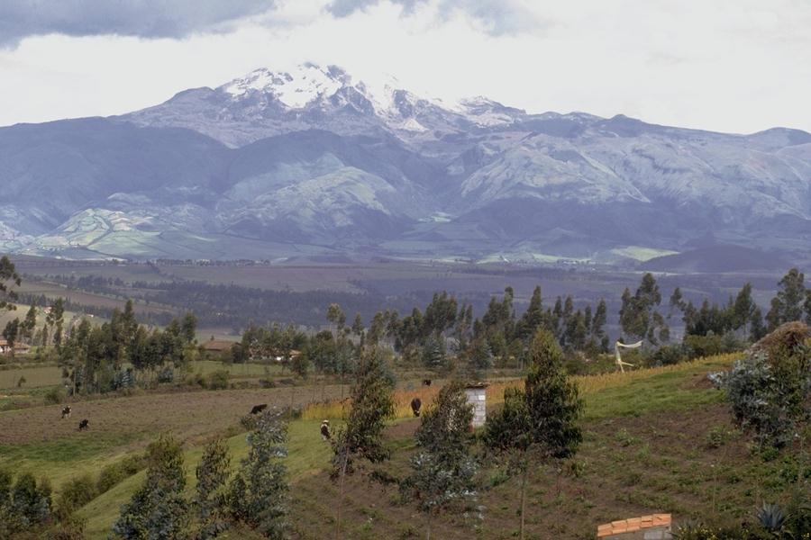

Slide 16
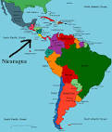
Take a look at Nicaragua
Watch 2:10 film of Nicaragua’s cities
https://www.youtube.com/watch?v=sDx36uEUwEQ

Slide 17
Here’s what Venezuela looks like
https://www.youtube.com/watch?v=06qhL4q7OOs

Slide 18
Inflation=a general increase in prices and fall in the value of money.

Slide 19
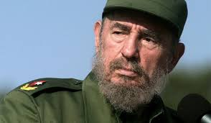
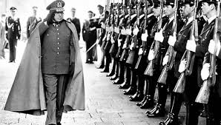
Harsh Government and Inequality

Slide 20
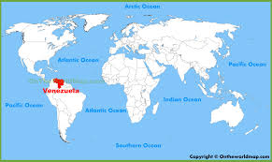
Watch film about Venezuela’s Economy
https://www.youtube.com/watch?v=JlCn9cCWwbo

Slide 21
Read page two of Explore & answer the question
Ask yourself
What’s challenging about a dictatorship?

Slide 22
Modern Latin American
Watch film [2:14]
https://app.discoveryeducation.com/learn/videos/d14d8a78-63d6-444c-9f38-bdf12b16e769/

Slide 23
Modern Latin American Government
Read page 3 and fill out chart
What political systems are used throughout Latin America today?
What economic systems are used?

Slide 24
Next-Explore 5-7

Slide 25
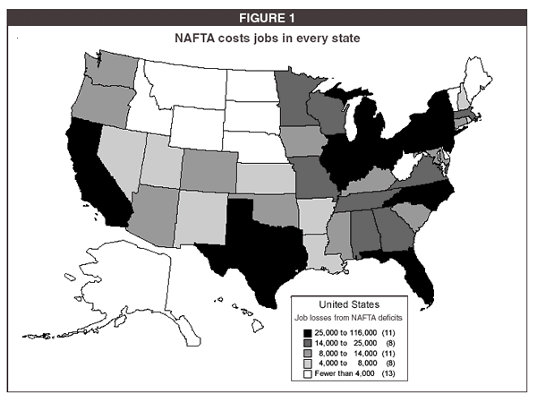

Slide 26
WAGE RATES COMPARED
$20.21
$25
$17.38
$20
$15
Mexico
$10
U.S.
$1.55
$2.87
$5
$0
Assemblers
Skilled Labor
History shows that over time, wages will increase in Mexico, closing the gap somewhat

