Slide 1
Latin America #1
Originally controlled by Spain and Portugal

Slide 2
Basic Geography, Climate, People Andes Mt., Grasslands, Rainforest, Farming
https://www.youtube.com/watch?v=7DMbqhVw9mg
5:31

Slide 3
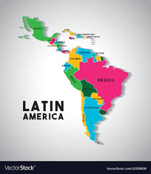
Latin America is a region in the Western Hemisphere that includes Mexico, Central America, the West Indies, and South America.

Slide 4
Goals
Locate Latin America on a world map
Describe the physical characteristics (i.e., landforms, climate, and vegetation) of Latin America

Slide 5
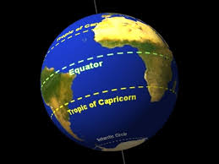
Paste in notebook
Latin America map-label Central and South America & Mexico, Equator, Tropic of Capricorn
World map-Label South America & Mexico

Slide 6
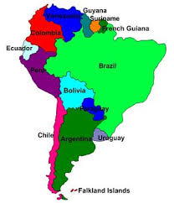
Latin America/South America
Latin America is an umbrella cultural concept just like Hispanic America.
South America, geographical concept, is a continent.
Which Latin American country is closest to U. S.?

Slide 7
vocab
Biome=flora (vegetation) and fauna (animals) occupying a major habitat, e.g. forest or tundra.
Subsistence farming= farmers grow crops to feed themselves and their families. Farm output is for survival with little or no surplus.
Amerindians=the indigenous people of the Americas
Indigenous=native, naturally there
Isthmus=narrow strip of land that connects two larger land areas.

Slide 8
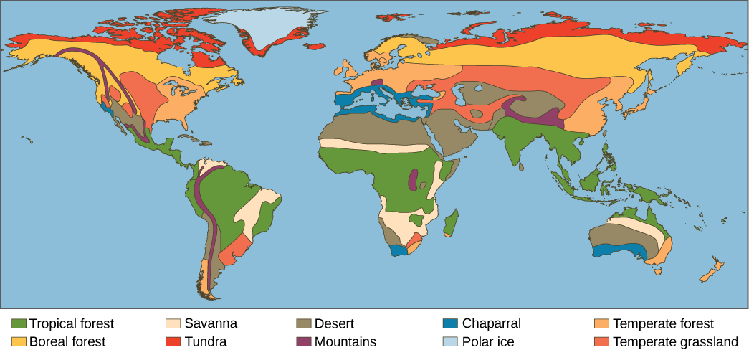
Climate determines where biomes are found.
Each biome has a range of temperatures and precipitation.
We can often predict what type of biome will be found there.

Slide 9
Begin Geography Graphic Organizer with discoveryeducation.com

Slide 10
Social Studies Techbook
Discoveryeducation.com
Username-
Password-huron
Course: World Geography and Cultures
Explore 1-7: Use the graphic organizer and answer questions.
Click on the map, choose large size. To compare to U.S. and Canada use search-physical map of United States and Canada.
When you use large, you’ll see a +/- to zoom in
Exit out of large
*Use back arrow to go to next Explore*

Slide 11
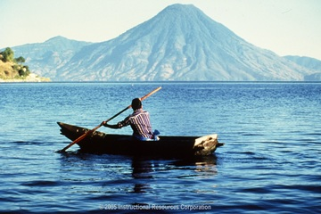
What do you see? What do you think conditions are like?

Slide 12
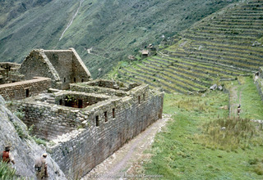

Slide 13
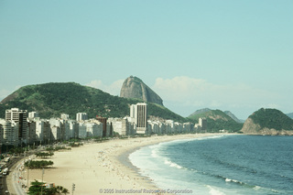

Slide 14
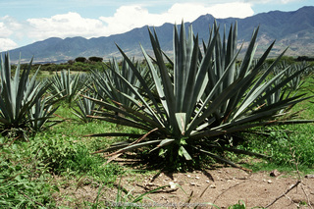

Slide 15
Project & test is May 10

Slide 16
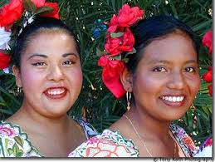
Latin America Population Majority
Mestizo=mixed race, especially one having Spanish and indigenous descent.

Slide 17
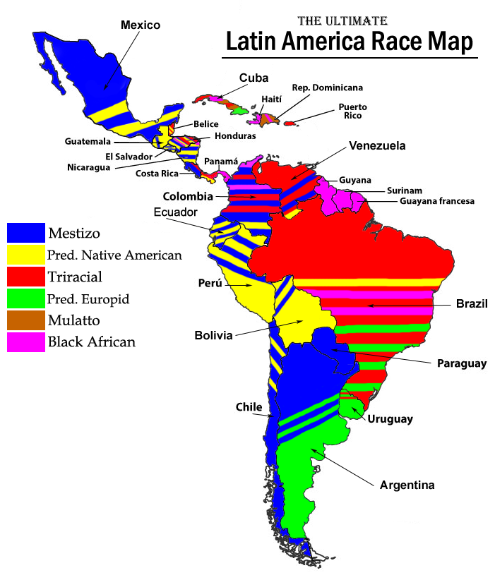

Slide 18
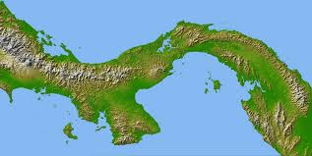
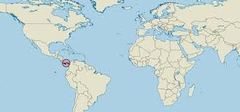
Vocabulary
Isthmus of Panama
WEST INDIES
(Caribbean Islands)
CENTRAL AMERICA
SOUTH AMERICA
Connects Central America and South America

Slide 19
The Panama Canal
Shortcut through land saves 7,000 miles of travel
Took 10 years to build after French gave up and U.S. took over
5,609 workers died, mostly from malaria or yellow fever carried by mosquitoes
40 ships cross daily; each can take up to 10 hours to get through the canal

Slide 20
Watch how the Canal works 6:54
https://www.youtube.com/watch?v=m8TkcWhmByg

Slide 21
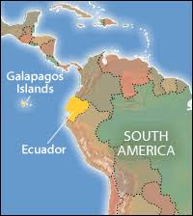
Galapagos Islands

Slide 22
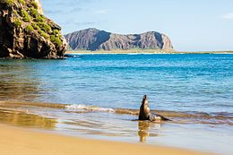
2 min. film of Galapagos which is part of the Republic of Ecuador
https://www.youtube.com/watch?v=8SYyHiot-lE
21 islands in the archipelago (string of islands)
25, 000 people live there

Slide 23
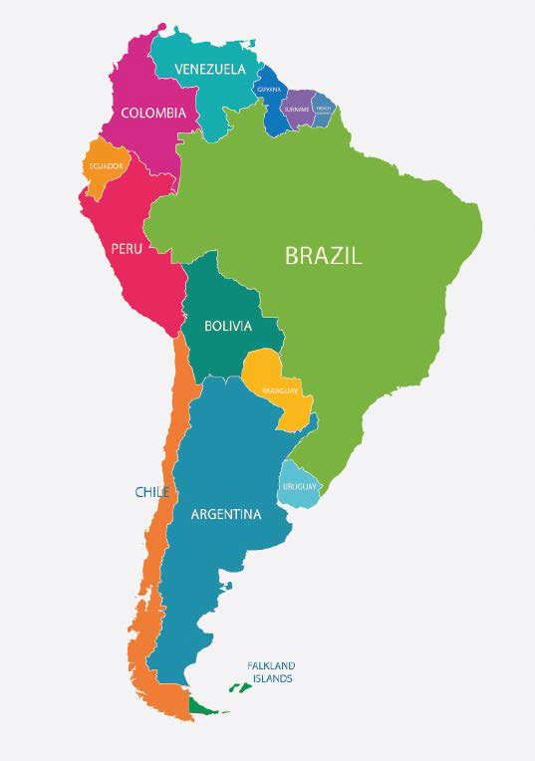
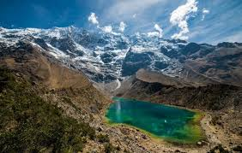
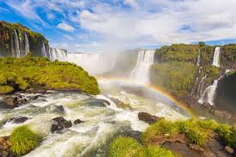
Peru, Argentina, Brazil
23% live in poverty
*Population: 209million
*25 % live below the poverty line
*family income of $5.50 a day.
*33% live below poverty line
*20% live on less than two dollars per day.

Slide 24
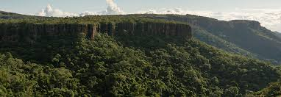
Brazil’s Mato Grosso Plateau Mostly savanna (grassy, with few trees) and woodland
Ecotourism=tourism to endangered areas for purpose of supporting conservation
Hectare=100 acres

Slide 25
Brazil’s Mato Grosso 3:41
https://www.youtube.com/watch?v=w46tBZdrvos

Slide 26
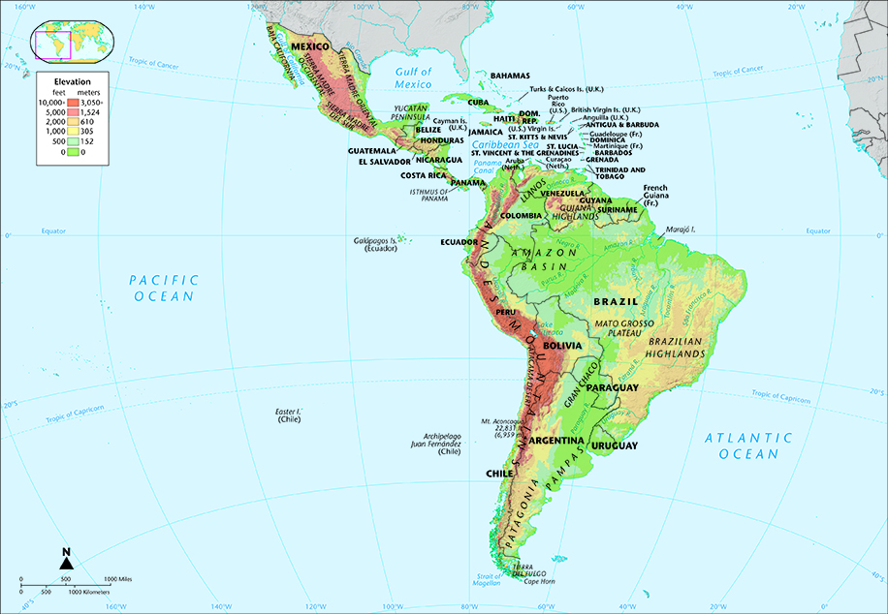
Reading an Elevation Map
Where are the highest land elevations?
ISLANDS WEST INDES
YUCATAN
PENINSULA
DARK BROWN= 10,000 ft.
Yucatan Peninsula?
The west coast of South America?
The islands of the West Indies?
Brazil’s Mato Grosso Plateau?
MATO GROSSO
GREEN=500 ft.
LIGHT BEIGE=100 FT.

Slide 27
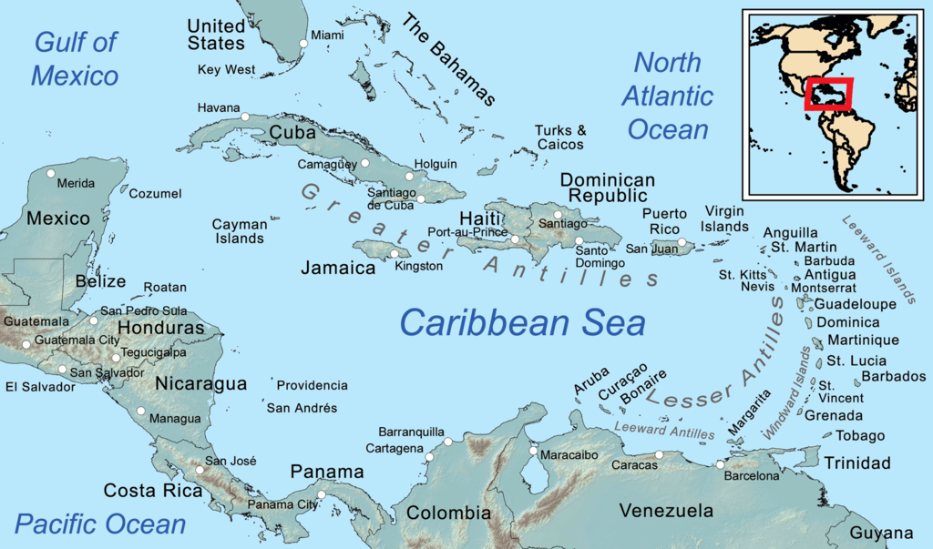
West Indies (Caribbean Islands)

Slide 28
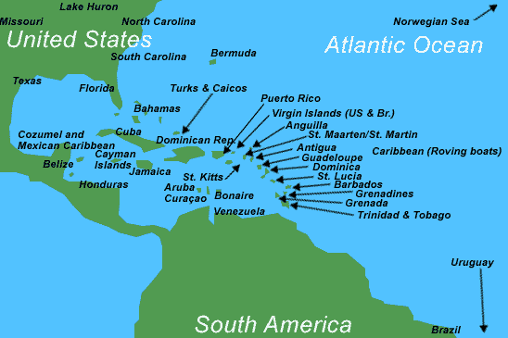
Islands of the West Indies (Caribbean)

Slide 29
West Indies mountain tops surrounded by water
Group of 5,000 volcanic and coral islands
Rich volcanic soil grows sugar cane, bananas, cacao, limes, and spices
Sandy beaches and warm weather
5-8 hurricanes per year
Active volcano
Strong French Influence

Slide 30
History of Caribbean Islands 4:43
What do you think the climate is like?
https://www.youtube.com/watch?v=YVkjwh6OavM

Slide 31
Caribbean Island Vacation Guide 11 min.
https://www.youtube.com/watch?v=SUXPxtVEeS4

Slide 32
Tropical Rainforest
The tropical rainforest is a hot, moist biome found near Earth's equator.
The world's largest tropical rainforests are in South America, Africa, and Southeast Asia.
Tropical rainforests receive from 60 to 160 inches of precipitation that is fairly evenly distributed throughout the year.

Slide 33
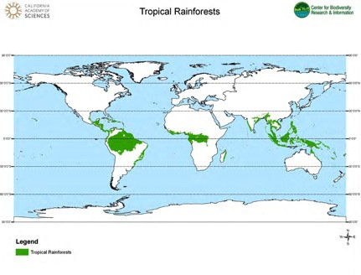

Slide 34
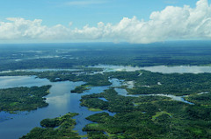
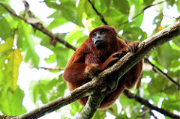
Rainforests cover around 2% of the Earth, but about 50 percent of the plants and animals on the earth live in the rainforest.
Very high annual rainfall, high average temperatures, nutrient-poor soil (rain washes organic materials away), and high levels of biodiversity (species richness).

Slide 35
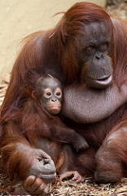

Slide 36
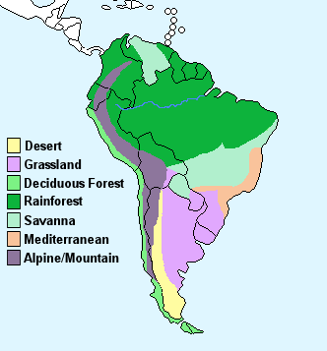
Biomes of South America
LARGE RAIN FORESTS
PAMPAS
EXPANSIVE GRASSLANDS

Slide 37
Bolivia
Varied terrain spanning Andes Mountains, the Atacama Desert and Amazon rainforest
Population: 11.05 million
60% live in poverty
38% in extreme poverty

Slide 38
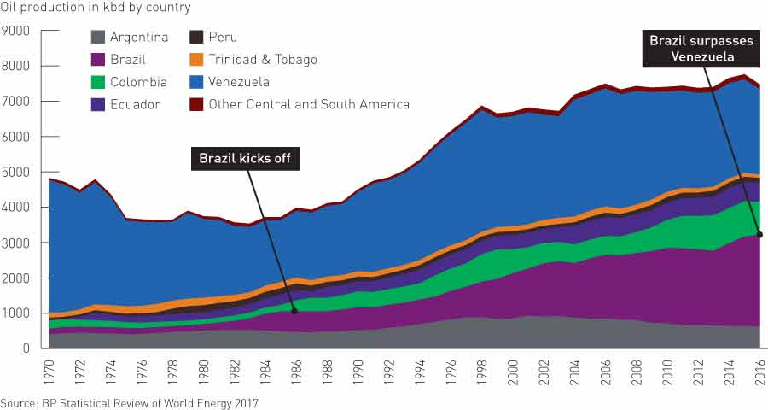
Petroleum Production

Slide 39
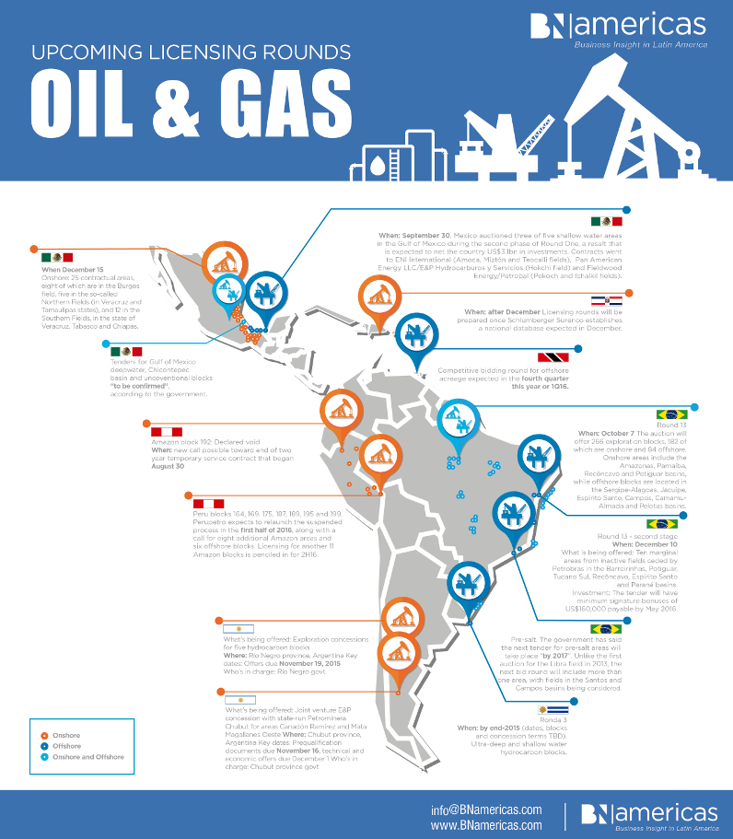

Slide 40
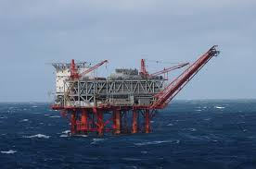
Latin America’s Economy
Fertilizer
Sugar
Wheat
Coffee
Rubber
Petroleum, especially Venezuela

Slide 41
Tomorrow, during social studies you be testing in the lab.
I still expect your test to be Friday.

Slide 42
How do present-day Latin Americans adapt to life, modify and depend on the environment in the Andes Mountains?
Use the Human-Environment Interaction in Latin America Categorization Chart as you
read pages 5-7

Slide 43
Page 8 Explore
As you read about the causes of natural disasters and the effects, fill out the cause/effect chart.

